Slide 1

Routing Protocols in IoT
Name: Shyam Sunder
Registration No: 2021PGCACA043

Slide 2
Agenda
What is Routing?
Understanding how routing works and it's types.
What is a Routing Protocol?
Discussion of LOADng protocol.
Summary

Slide 3
What is routing?
In networking, routing is the process of moving a packet of data from source to destination.
The routing process performed by a router typically directs forwarding on the basis of routing tables, which maintain record of the routes to various network destinations.
A routing table can be compared to a train timetable, where train passengers consult the timetable to decide which train to catch. Routing tables function in the same way, but for network paths rather than trains. These tables may be specified by an administrator, learned by observing network traffic, or built with the assistance of routing protocols.

Slide 4
How routing works and it’s types?
When a router receives a packet, it reads the headers of the packet to see its intended destination. It then determines where to route the packet based on information in its routing table. As a packet travels to its destination, it may be routed multiple times by several routers. Routers perform this process millions of times a second with millions of packets.
Types:
1. Static routing: Routes are manually added into the routing table.
2. Dynamic routing: Adjustments of the routes are automatically made according to the current state of the route in the routing table. Dynamic routing uses protocols to discover network destinations and the routes to reach it.

Slide 5
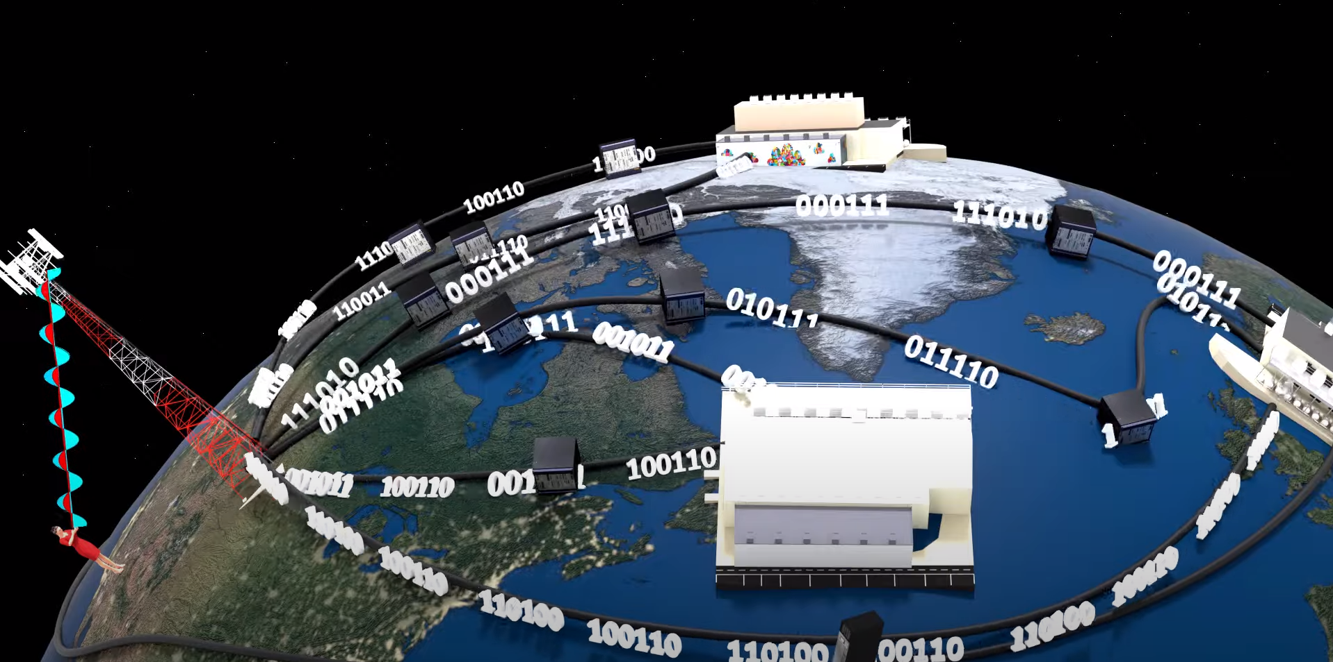
An image depicting flow of data packets from source to destination in a network
Flanker

Slide 6
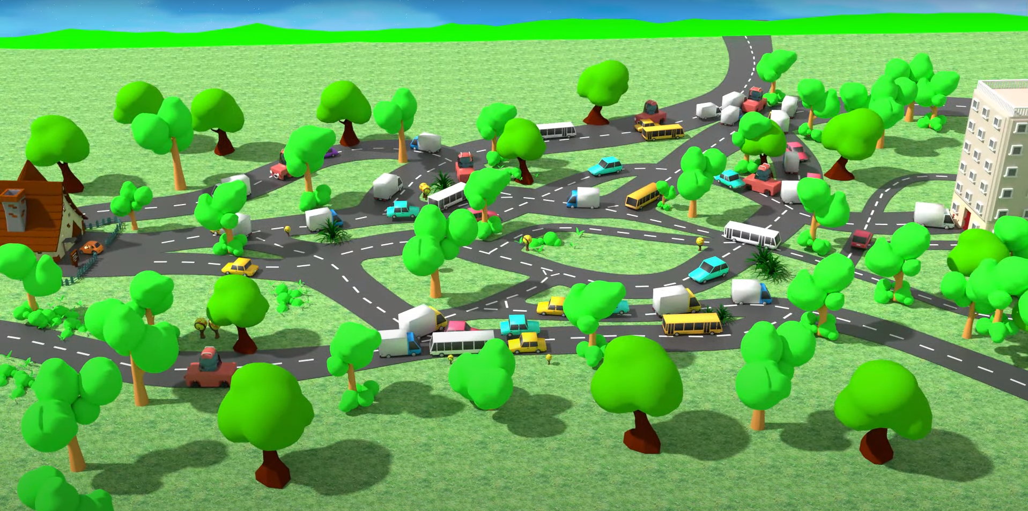
A real life analogy of routing

Slide 7
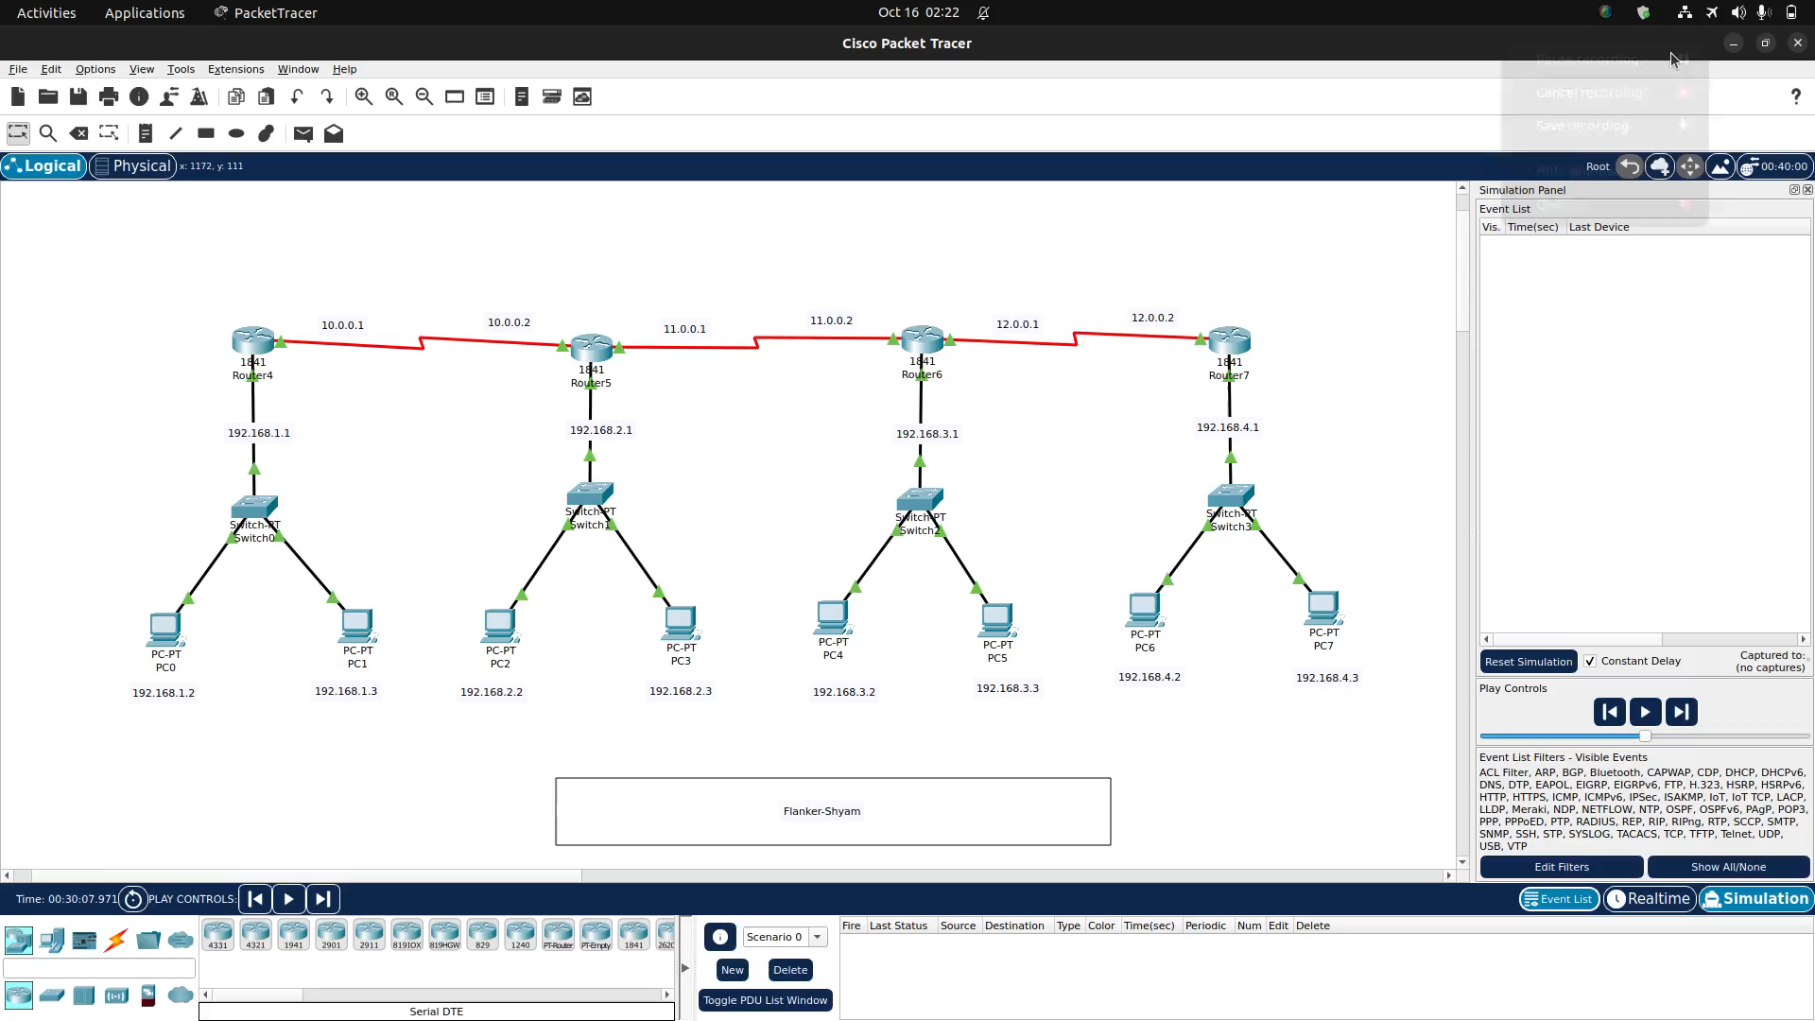
Flanker

Slide 8
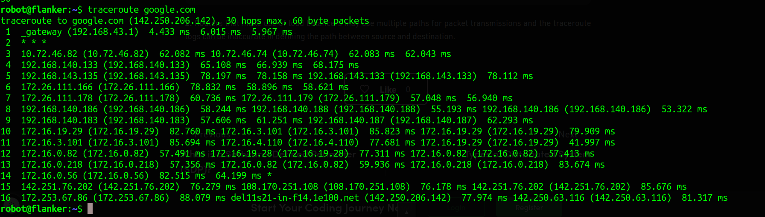
Output of traceroute command

Slide 9
What is a Routing Protocol?
A routing protocol uses software and routing algorithms to determine optimal network data transfer and communication paths between network nodes. Routing protocols facilitate router communication and overall network topology understanding.
A routing protocol is also known as a routing policy.
Most Internet Protocol (IP) networks use the following routing protocols:
Routing Information Protocol (RIP) and Interior Gateway Routing Protocol (IGRP): These provide interior gateway routing through path or distance vector protocols.
Open Shortest Path First (OSPF): This provides interior gateway routing through link-state routing protocols.
Border Gateway Protocol (BGP) v4: This provides public Internet routing protocol through exterior gateway routing

Slide 10
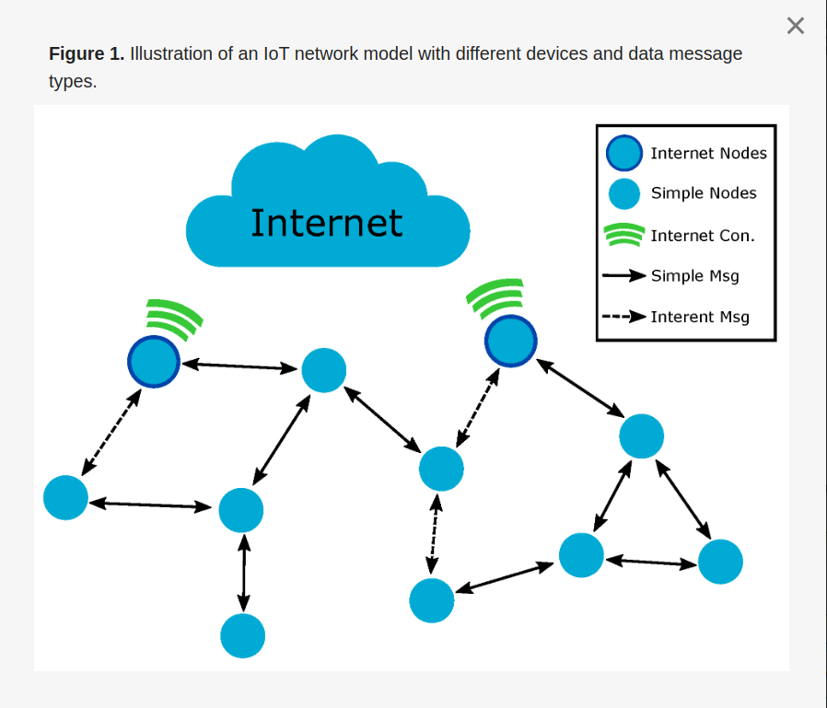
Routing in IoT
Depending on the application, the nodes in an IoT
network can have different hardware capacities
and application objectives.
In the IoT scenario presented in Figure 1, some
network nodes can have a direct Internet
connection to send and receive messages from the
Internet. In contrast, other nodes from the same
network, due to hardware limitations, cannot have
a direct Internet connection and require the use of
the Internet-connected nodes to access external
services. All of these nodes can also exchange
information in a local context without the necessity
of transmitting data to the Internet.

Slide 11
The routing protocols in IoT can be grouped into two types based on the route creation principles:
1. Proactive: Proactive protocols begin the creation of routes among the nodes without the prior necessity of data message transmission. The route creation process is, in general, triggered by gateway nodes that have the function of collecting information from other network devices
2. Reactive: Reactive protocols create routes only when a node intends to send a message to a destination. Thus, the route discovery process is triggered by the node that wants the message. The created routes are maintained in the routing table of the nodes, remaining while in use and removed afterwards.

Slide 12
A type of Reactive protocol : LOADng protocol in IoT
When a node wants to send a data message, it should look for a route to the message destination on its Routing Set. If the path is found, the node should forward the message to its destination through the next hop node. However, if the wanted destination is not found, the node should start a new route discovery process.
LOADng is a reactive routing protocol based on route discovery using route request and route reply messages.
Thus, when a node wants to send a data message and the route to the destination is unknown, it should begin a new route discovery process.
To this end, the node broadcasts a route request (RREQ) message to search for a route to the desired destination. Each node that receives an RREQ should perform message processing and consider the message to be forwarded.
This process continues until the RREQ reaches the sought destination.
The destination should then generate a route reply (RREP) message to answer the received RREQ. The RREP is forwarded in unicast to the RREQ originator, constructing a route between the two nodes interested in the message exchange.
Finally, the RREP is received by the RREQ originator, which should begin to send data messages using the path created by the route discovery process.

Slide 13
Thank you!
Link to my Github @Flanker-shyam
Link to install Cisco Packet Tracer

